Slide 1
CSS
Cascading Style Sheets

Slide 2
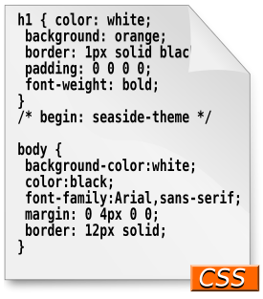
CSS
Cascading Style Sheets (CSS): is a simple mechanism for adding style (e.g. fonts, colors, layouts) to Web documents.
Styles provide powerful control over the presentation of web pages

Slide 3
What is CSS? (1)
What is CSS?
CSS stands for “Cascading Style Sheets”
Cascading: refers to the procedure that determines which style will apply to a certain section, if you have more than one style rule.

Slide 4
What is CSS? (2)
What is CSS?
CSS stands for “Cascading Style Sheets”
Style: how you want a certain part of your page to look. You can set things like color, margins, font, etc for things like tables, paragraphs, and headings.

Slide 5
What is CSS? (3)
What is CSS?
CSS stands for “Cascading Style Sheets”
Sheets: the “sheets” are like templates, or a set of rules, for determining how the webpage will look.
So, CSS (all together) is a styling language – a set of rules to tell browsers how your webpage should look.

Slide 6
What is “Style”?
What is “Style”
“Style” is a command that you set to tell the browser how a certain section of your webpage should look.
You can use style on many HTML “elements”
(like <p> <h1> <table> etc)

Slide 7
What is “Style”?
Enter CSS Timeline
CSS1- December 1996
CSS 2- Became a W3C Recommendation in May 1998
CSS 3- CSS level 3 has been under development since December 15, 2005

Slide 8
What is “Style”?
CSS Versions
CSS 1
Font properties such as typeface and emphasis
Color of text, backgrounds, and other elements
Text attributes such as spacing between words, letters, and lines of text
Alignment of text, images, tables and other elements
Margin, border, padding, and positioning for most elements
Unique identification and generic classification of groups of attributes
CSS2
includes a number of new capabilities like
absolute, relative, and fixed positioning of elements and z-index,
the concept of media types
support for aural style sheets and bidirectional text
new font properties such as shadows.

Slide 9
What is “Style”?
CSS Versions
CSS3
Modules include:
Borders (border-radius, box-shadow)
Backgrounds (multiple backgrounds)
Color (HSL colors, HSLA colors, opacity, RGBA colors)
Also:
media queries
multi-column layout
Web fonts

Slide 10
What is “Style”?
The Separation of Style, Content and Behavior
Core Concept of web development
HTML + CSS + JavaScript
Content + Style + Behavior

Slide 11
How to write style rules (1)
How to write style rules
Two parts: (1) selector and (2) declaration.
Selector: the HTML element you want to add style to.
<p> <h1> <table> etc
Declaration: the statement of style for that element. Made up of property and value.
Notes:
Selector: the thing I want to make styled: a paragraph, a table, a header, etc.
Declaration: what I want to do to my paragraph, table, header, etc.

Slide 12
How to write style rules (2)
How to write style rules
Selector {declaration;}
Declaration = {property: value;}
Property: what aspect you want to change
ex: color, font, margins, etc.
Value: the exact setting for that aspect.
ex: red, italic, 40px, etc.

Slide 13
How to write style rules (2)
How to write style rules
selector {property: value;}
Essentially means:
The thing I want to change
{the aspect of that thing I want to change: what I want it to be;}

Slide 14
How to write style rules (3)
How to write style rules
Selector {property: value;}
h1 {color: red;}
Means: I want the text color of my heading1 to be red.
Notes:
This is if you are writing an embedded style rule!

Slide 15
How to write style rules (3)
How to write style rules
Selector {property: value;}
I want the color of the text in my paragraph to be yellow.
P{color: yellow;}
This is the text in this paragraph.
Notes:
This is if you are writing an embedded style rule!

Slide 16
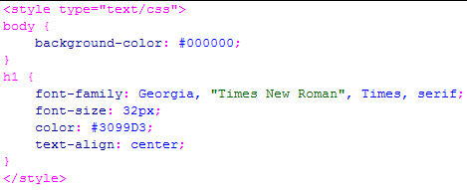
CSS
selector
property
value
rule

Slide 17
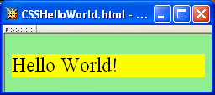
CSS
A styled HTML document produced by the style sheet style1.css:

Slide 18
CSS:
HTML:
body {
font-family: Tahoma, Arial, sans-serif;
font-size: 13px;
color: black;
background: white;
margin: 8px;
}
h1 {
font-size: 19px;
margin-top: 15px;
margin-bottom: 5px;
border-bottom: 1px solid black
}
.shaded {
background: #d0d0ff;
}
<body>
<h1>First Section Heading</h1>
<p>
Here is the first paragraph, containing
text that really doesn't have any use
or meaning; it just prattles on and on,
with no end whatsoever, no point to
make, really no purpose for existence
at all.
</p>
<div class="shaded">
<h1>Another Section Heading</h1>
<p>
Another paragraph.
</p>
</div>
</body>

Slide 19
Three Different Scopes of CSS
Local
confined to a single element (tag)
Internal
affect elements in an entire page
External
can affect multiple pages
Precedence
Local > Internal > External

Slide 20
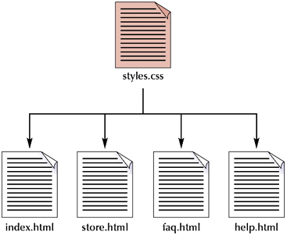
Applying a single style sheet to multiple documents

Slide 21
a) Inlined example-1
<html>
<head><title>My Wonderful Example</title>
</head>
<body>
<p>What was I thinking?</p>
</body>
</html>
Original html code

Slide 22
a) Inlined example-2
<body>
<p style=“text-align: center; font- weight: bold; color: yellow;”>What was I thinking?</p>
</body>
What was I thinking?

Slide 23
b) Embedded/Internal-1
<head><title>My Wonderful Example</title>
<style type=“text/css”>
body
{text-align: left;
font-family: trebuchet, verdana;}
</style>
</head>

Slide 24
b) Embedded/Internal-2
<head><title>My Wonderful Example</title>
<style type=“text/css”>
body
{ text-align: left;
font-family: Trebuchet, verdana;
}
</style>
</head>
this is a style sheet (style type) written (text) in css (CSS) language
I want the “align text” property to be given the value of “left”

Slide 25
c) External
<html>
<head><title>My Way</title>
<link rel="stylesheet" href="http://www2.hawaii.edu/~myway. css" type="text/css“>
</head>
<body> </body>
</html>
Link to a separate css page

Slide 26
CSS
link element associates style sheet with doc.

Slide 27
CSS
type attribute specifies style language used

Slide 28
CSS
href attribute provides style sheet URL

Slide 29
CSS
title attribute provides style sheet name

Slide 30
CSS
Alternative, user selectable style sheets
can be specified

Slide 31
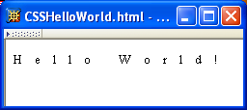
CSS
A styled HTML document produced by the style sheet style2.css:

Slide 32
CSS Syntax: Selector Strings
Source anchor elements:
Element types that are descendents:
pseudo-classes

Slide 33
CSS Syntax: Selector Strings
Source anchor elements:
Element types that are descendants:
rule applies to li element that is

Slide 34
CSS Syntax: Selector Strings
Source anchor elements:
Element types that are descendants:
rule applies to li element that is
part of the content of an ol element

Slide 35
CSS Syntax: Selector Strings
Source anchor elements:
Element types that are descendants:
rule applies to li element that is
part of the content of an ol element
that is part of the content of a ul element

Slide 36
CSS Syntax
Style rules covered thus far follow ruleset syntax
At-rule is a second type of rule
Reads style rules from specified URL
Must appear at beginning of style sheet
URL relative to style sheet URL

Slide 37
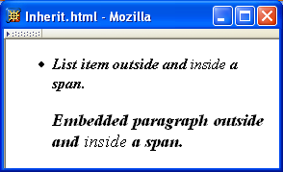
CSS Inheritance

Slide 38
Selectors
3 types of selectors
Tag selectors
ID selectors
Class selectors
Selectors should never start with a number, nor should they have spaces in them

Slide 39
Tag Selectors
Can be any type of HTML element
body
p
div
p {
background-color: red;
}

Slide 40
{ The class Selector
With the class selector you can define different styles for the same type of HTML element.
p.right {text-align: right}
p.center {text-align: center}
Using the class argument in (X)HTML:
<p class="right"> This paragraph will be right-aligned. </p>
<p class="center"> This paragraph will be center-aligned. </p>

Slide 41
The class Selector
defines different styles for the same element:
p. center {text-align: center}
in HTML document:
<p class=“center”>Paragraph</p>

Slide 42
The class Selector
.center {text-align: center}
means:
<h1 class="center">Heading is centered</h1>
<p class="center">Paragraph is centered</p>

Slide 43
The class Selector
Class Selectors
<H1 CLASS=“warning”>Danger!</H1>
<P CLASS=“warning”>Be careful…</P>
…….
In your HTML code -
H1.warning {color: red;}
OR to an entire class…
.warning {color:red;}

Slide 44
{ Text color
This is header 1
This is header 2
This is a paragraph
<html><head>
<style type="text/css">
h1 {color: green}
h2 {color: #dda0dd}
p {color: rgb(0,0,255)}
</style>
</head>
<body>
<h1>This is header 1</h1>
<h2>This is header 2</h2>
<p>This is a paragraph</p>
</body>
</html>

Slide 45
ID Attribute
there can be only one element with a given id in a document:
to match all elements with a id:
#intro {font-weight:bold; color: #0000ff}
only elements with id="intro":
p#intro {font- weight:bold; color:#0000ff;}

Slide 46
ID Selectors
ID's vs. Classes... an epic battle.
You can not have two elements on one page with the same ID
#sidebar {
background-color: blue;
}

Slide 47
Grouping Selectors
You can group selectors together as well with commas
p.warning, p.special {
color: red;
}
Now both classes, warning and special, will have red text.

Slide 48
Reset the Styling
/* Normalizes margin, padding */
bodv, h1, h2, h3, h4, h5, h6, p, ol, ul, dt, dl, dd, fo, blockquote, fieldset, input { padding: 0; margin: 0; }
/* Normalizes font-size for headers */
h1, h2, h3, h4, h5, h6 { font-size: 1em; }
/* Removes list-style from lists */
ol, ul { list-style: none; }
/* Removes text-decoration from links */
a { text-decoration: none; }
/* Removes border from img */
a img { border: none; }

Slide 49
{ Grouping
h1,h2,h3,h4,h5,h6
{
color: green
}
All header elements will be displayed in green text color
This is header h1
This is header h2
This is header h3
This is header h4
Note: each selector has been separated with a comma.

Slide 50
A Very Brief Overview of Visual Formatting With CSS
Visual Formatting
Fonts
Colours
Position
Box model and Borders

Slide 51
CSS Font Properties
A font family is a collection of related fonts (typically differ in size, weight, etc.)
font-family property can accept a list of families, including generic font families
first choice font

Slide 52
CSS Font Properties
A font family is a collection of related fonts (typically differ in size, weight, etc.)
font-family property can accept a list of families, including generic font families
second choice font

Slide 53
CSS Font Properties
A font family is a collection of related fonts (typically differ in size, weight, etc.)
font-family property can accept a list of families, including generic font families
generic

Slide 54
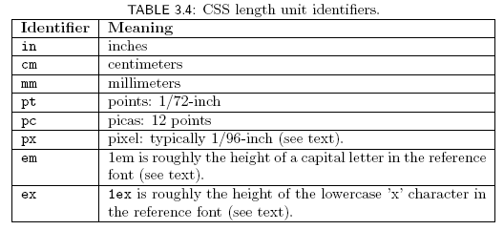
CSS Font Properties
Many properties, such as font-size, have a value that is a CSS length
All CSS length values except 0 need units

Slide 55
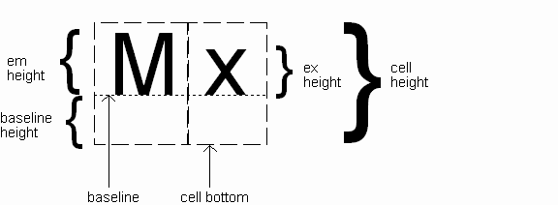
CSS Font Properties
Computed value
of font-size property

Slide 56
CSS Font Properties
Reference font defines em and ex units
Normally, reference font is the font of the element being styled
Exception: Using em/ex to specify value for font-size
parent element’s font is
reference font

Slide 57
CSS Font Properties
Other ways to specify value for font-size:
Percentage (of parent font-size)
Absolute size keyword: xx-small, x-small, small, medium (initial value), large, x-large, xx-large
User agent specific; should differ by ~ 20%
Relative size keyword: smaller, larger
Relative to parent element’s font

Slide 58
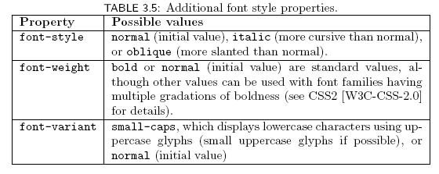
CSS Font Properties

Slide 59

CSS Font Properties
Text is rendered using line boxes
Height of line box given by line-height
Initial value: normal (i.e., cell height; relationship with em height is font-specific)
Other values (following are equivalent):

Slide 60
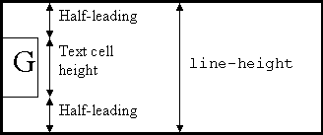
CSS Font Properties
When line-height is greater than cell height:
Inheritance of line-height:
Specified value if normal or unit-less number
Computed value otherwise

Slide 61
CSS Font Properties
font shortcut property:

Slide 62
CSS Font Properties
font shortcut property:
Initial values used if no value specified in font
property list (that is, potentially reset)

Slide 63
CSS Font Properties
font shortcut property:
specifying line-height (here, twice cell height)
any order
size and family required,
order-dependent

Slide 64
Colors
There are sixteen pre-defined colors in HTML:
aqua, black, blue, fuchsia, gray, green, lime, maroon, navy, olive, purple, red, silver, teal, white, and yellow
Which means you can just type the word “blue” into your code, and the browser will give you the default color for blue

Slide 65
Colors
If you want more variety or nuance, there are also 216 “web safe colors” that all browsers should be able to read accurately.
These are the “HEX” color code system, i.e.
#000000 = black (total absence of color)
#FFFFFF = white (presence of all colors)
#FF0000 = red (the red section at full level)
#FF8800 = a shade of orange (red plus green)

Slide 66
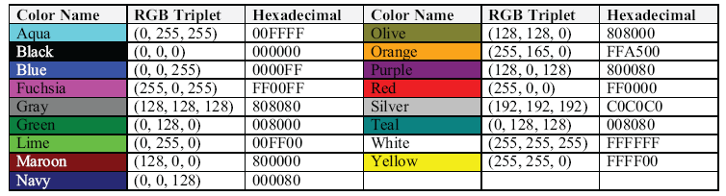
Colors
Body
{
color: black;
background: white;
}
= text color is black, background color is white

Slide 67
CSS Color Specifiers
Predefined names:
white red …
8-bit hexadecimal intensities for red, green, blue:
0-255 decimal intensities:
Percentage intensities:
#ff0000
R
G
B
rgb(255,255,0)
R
G
B
rgb(80%,80%,100%)
R
G
B

Slide 68
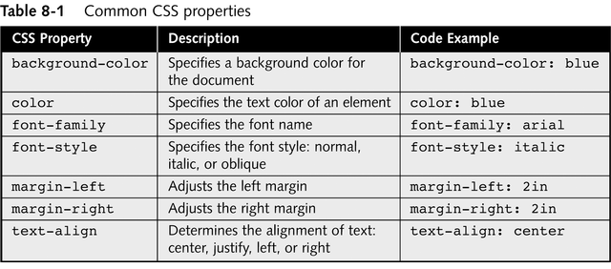
Common CSS Properties

Slide 69
Common CSS Properties

Slide 70
CSS Text Formatting

Slide 71
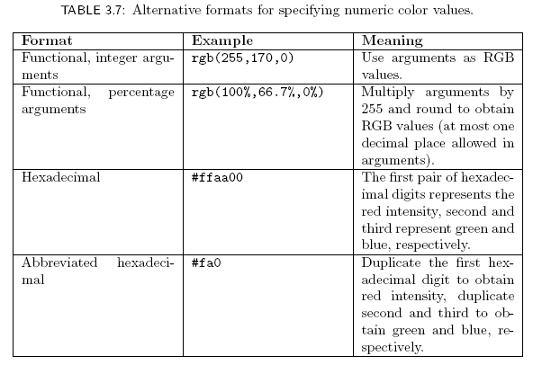
CSS Text Color

Slide 72
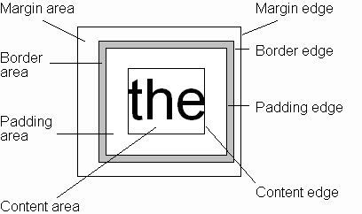
CSS Box Model
Every rendered element occupies a box:
(or outer edge)
(or inner edge)

Slide 73
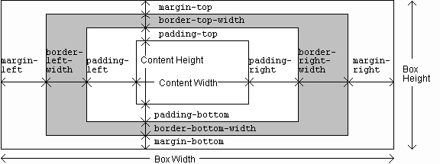
CSS Box Model

Slide 74
The CSS Box Model
Every CSS box is divided into regions, consisting of:
Content
Padding
Border
Margins

Slide 75
The CSS Box Model
Margin
Border
Padding
Content

Slide 76
Margins & Padding
Margins
Margins define the space around elements outside the border
Margin properties can have negative values in order to deliberately overlap content
Margin properties will affect the position of background elements (graphics and/or colours) in relation to the edges of the containing block element
Margin properties can be defined independently on top, right, bottom and left, or all-at-once using CSS shorthand

Slide 77
Margins & Padding
Padding
Padding defines the space around elements inside the border; i.e between the border and the content itself
Padding properties cannot have negative values
Padding properties do not affect the position of background elements (graphics and/or colours) in the containing block element; only the position of content.
Padding properties can be defined independently on top, right, bottom and left, or all-at-once using CSS shorthand

Slide 78
CSS Shorthand: Margin & Padding
For margin and padding (and others), CSS provides a number of shorthand properties that can save on writing lines and lines of code. Instead of writing this:
#container { margin-top: 0; margin-right: 5px; margin-bottom: 6px; margin-left: 5px; padding-top: 20px; padding-right: 10px; padding-bottom: 30px; padding-left: 12px; }
0
12
Content Area
5
5
12
10
30
6

Slide 79
CSS Shorthand: Margin & Padding
…Its much easier to write this:
#container { padding: 20px 10px 30px 12px; margin: 0px 5px 6px 5px; }
The sequence order is always clockwise, starting from the top
0
20
Content Area
5
5
12
10
30
6

Slide 80
CSS Shorthand: Margin and Padding
You can also apply just one value, example:
#container { padding: 20px; margin: 5px; }
Which will apply the value specified equally on all 4 sides
5
20
5
Content Area
5
20
20
20
5

Slide 81
CSS Shorthand: Margin and Padding
And you can apply two values, example:
#container { padding: 10px 20px; margin: 0px 5px; }
The first value is applied to the top and bottom
The second value is applied to the left and right
0
10
5
Content Area
5
20
20
10
0

Slide 82
CSS Shorthand: Margin and Padding: auto
A useful value to remember is ‘auto’:
#container { padding: 10px 20px; margin: 0px auto; }
Usually applied to the left & right areas of the margin property, auto is useful for centering a block container element in the browser window
0
10
auto
Content Area
auto
20
20
10
0

Slide 83
{ Background:
Control over the background color of an element
set an image as the background,
repeat a background image
background-color
color-rgb color-hex color-name
background-image
url(URL) none
background-repeat
repeat repeat-x repeat-y no-repeat

Slide 84
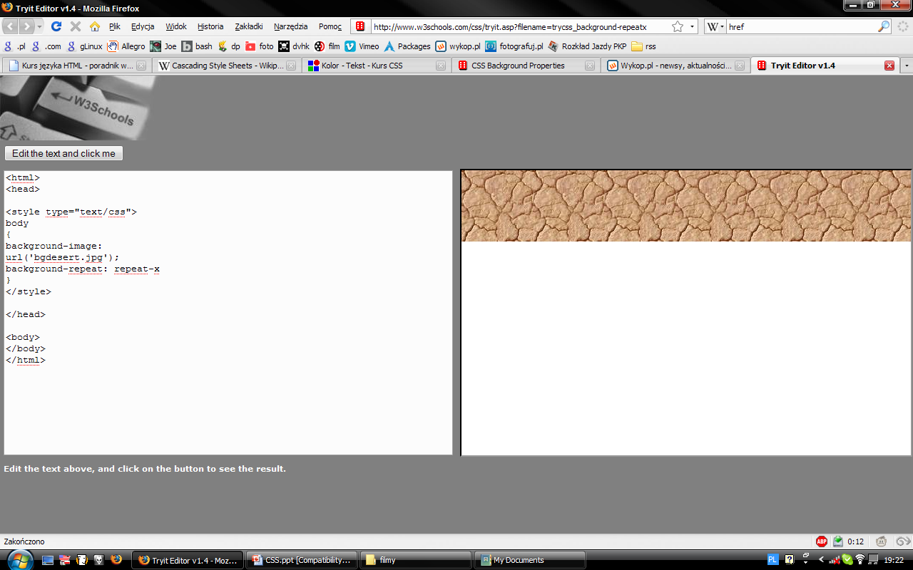


Slide 85
{Text:
color
direction
ltr rtl
word spacing
normal length
text-decoration
none underline overline line-through blink
text-align
left right center justify

Slide 86
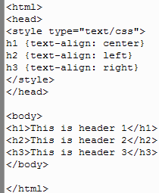
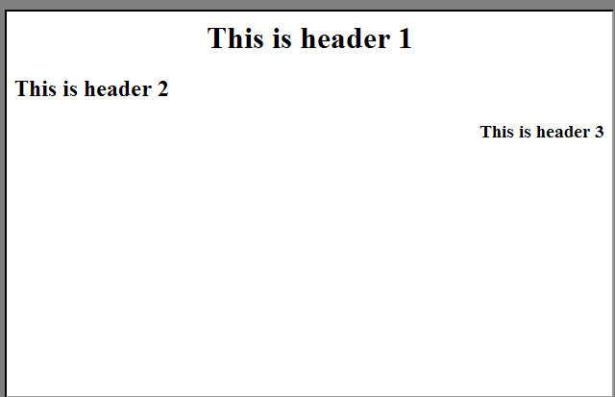

Slide 87
{Font:
font-family
family-name generic-family
font-size
xx-small x-small small
/etc./
font-weigh
normal bold bolder lighter 100

Slide 88
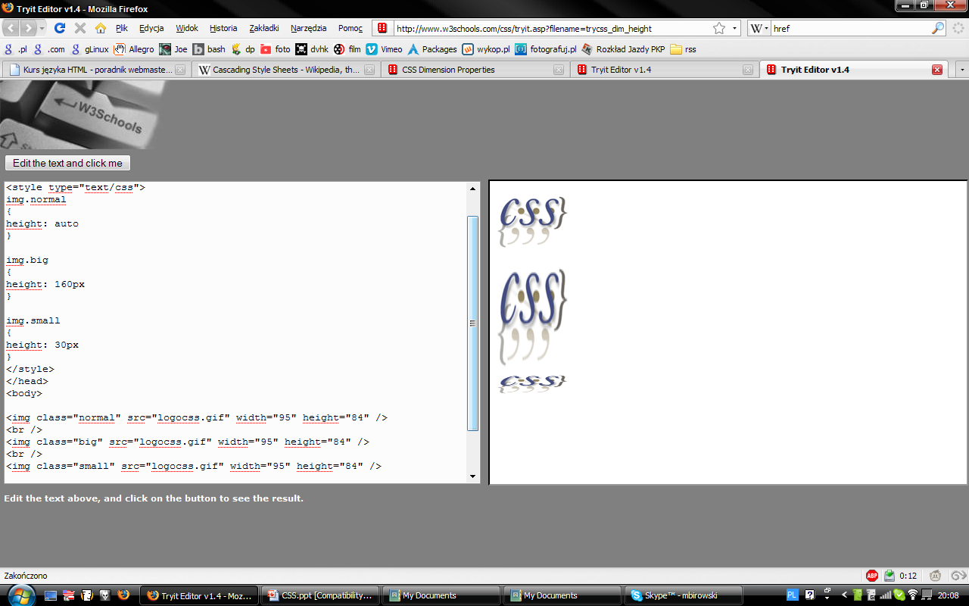
{Dimension

Slide 89
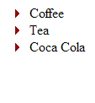
{List:
<head>
<style type="text/css">
ul
{
list-style-image: url('arrow.gif')
}
</style>
</head>
<body>
<ul>
<li>Coffee</li>
<li>Tea</li>
<li>Coca Cola</li>
</ul>
</body>

Slide 90
Visual Formatting: Images
position:
static, relative, absolute, fixed
Static — normal elements
Relative — translate from usual position
Absolute — scroll with the page
Fixed — like absolute, but don't scroll away
Example: Jon Gunderson

Slide 91
Visual Formatting: Images (cont.)
z-index: depth
float and clear
float: left or float: right or float: none
Position relative to parent element
Reset with clear
<br style="clear:both" />

Slide 92
Basic Formatting of the ‘Jump Box’
HTML Outline
<body>
<!-- … -->
<div class="up">
<dl>
<dt>Jump to top</dt>
<!-- … -->
</div>
</body>
Extract of CSS Rules
body
{margin-left: 6.3em}
div.up
{position: fixed;
left: 1em;
top: 40%;
padding: .2ex;
min-width: 5.5ex }

Slide 93
Relative and Absolute Positioning
position property:
static – box is positioned according to normal flow
relative – box is positioned relative to where it would have been placed in the normal flow
absolute – box is positioned relative to its containing block; these boxes are taken out of flow
fixed – box is fixed in relation to the viewport (a browser window or a printed page)

Slide 94
Margin Styles
Control your margins with the following four styles:
margin-top: length
margin-right: length
margin-bottom: length
margin-left: length
Margin values can also be negative. This creates an overlay effect by forcing the browser to render one element on top of another
You can also combine the four margin styles into a single style:
margin: top right bottom left

Slide 95
Padding Styles
Styles to set padding are similar to styles to set margins:
padding-top: value
padding-right: value
padding-bottom: value
padding-left: value

Slide 96
Border Styles
border-top-width: length
border-right-width: length
border-bottom-width: length
border-left-width: length
border-width: top right bottom left
border-top-color: color
border-right-color: color
border-bottom-color: color
border-left-color: color
border-color: top right bottom left

Slide 97
Border Styles
border-top-style: type
border-right-style: type
border-bottom-style: type
border-left-style: type
border-style: top right bottom left

Slide 98
Table Design
Tables can build a nice layout
Tables are predictable
Alternative Design Method
DIVs can be an alternate to <table>
DIVs are a container like a table cell
CSS can position the DIV
<div id="article">xxx</div>
#article{
width:250px;
padding:5px;
float:right;}

Slide 99
DIV Design
Use DIVs to create the skeleton of the page.
There should be no display-specific information in the XHTML
The Goal: separate the information from the layout / presentation of the page
Layout is entirely controlled by CSS

Slide 100
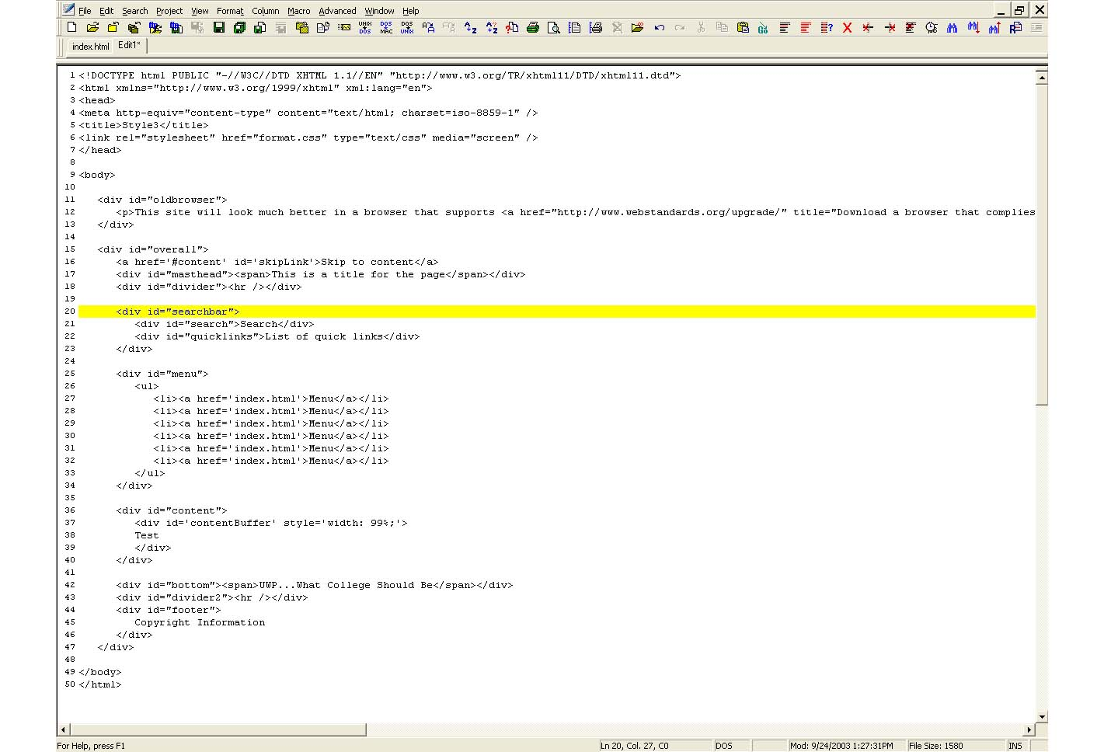
CSS

Slide 101
Normal Flow Layout
Block
elements
only

Slide 102
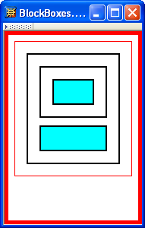
Normal Flow Layout
html
body
div d1
div d2
div d3
div d4
Top edges of
block boxes are
in document order

Slide 103
Building Navigation Bars
At heart, a navigation bar is nothing more than a bunch of links. More specifically, it’s actually a list of the different sections of a site. Lists provide us with a way of grouping related elements and, by doing so, we give them meaning and structure.

Slide 104
Building Navigation Bars
A navigation menu is based on a simple list inside a div, like this:
<div id=“NavBar">
<ul>
<li><a href="#">Home</a></li>
<li><a href="#">About</a></li>
<li><a href="#">Events<a/></li>
<li><a href="#">Forum</a></li>
</ul>
</div>

Slide 105
<div class=”header”>Title</div>
Divs help add structure to a page. Div stands for division and marks a logical group of elements on a page.
Divs divide the page into rectangular, box-like areas. Invisible unless you turn on borders or color background.
Include <div> tags for all major regions of your page, such as header, main content, sidebar, etc.

Slide 106
Divs <div>
Once your <div> tags are in place, add either a class or ID for styling each <div> separately.
For parts of the page that appear only once and form the basic building blocks of the page, web designers usually use an ID.
ID selectors are identified using a hash character (#); class selectors are identified with a period(.).

Slide 107
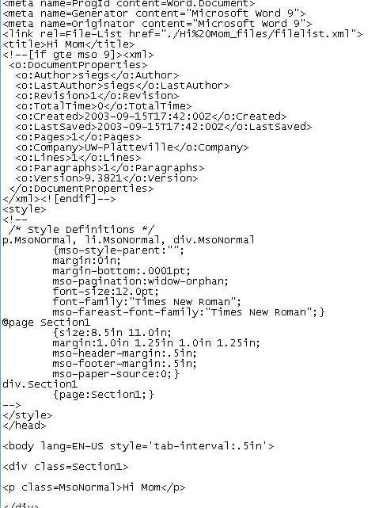

Slide 108
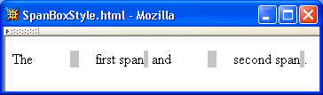
CSS Box Model

Slide 109
CSS Box Model

Slide 110
CSS Box Model

Slide 111
CSS Box Model

Slide 112
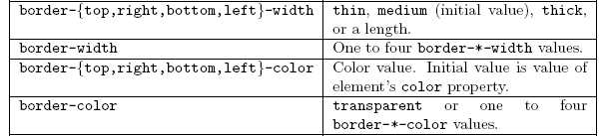
CSS Box Model

Slide 113
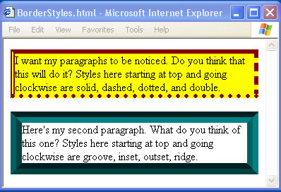
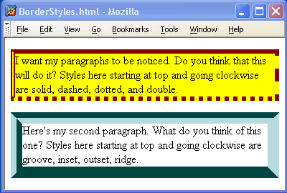
CSS Box Model

Slide 114
CSS Box Model

Slide 115
CSS Box Model
If multiple declarations apply to a property, the last declaration overrides earlier specifications
Left border is 30px wide,
inset style, and red

Slide 116
Backgrounds
background-color
Specifies background color for content, padding, and border areas
Margin area is always transparent
Not inherited; initial value transparent
background-image
Specifies (using url() function) image that will be tiled over an element

